Slide 1
Massachusetts’ Accelerating Clean Transportation (ACT) School Bus Program
September 24, 2024
www.cesa.org
Notes:
Title Slide – for all CESA webinars except ESTAP

Slide 2
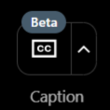
Webinar Logistics
Webinar Logistics
We are using the newly updated version of GoToWebinar!
Thank you for your patience as we get used to this new platform. We encourage you to provide feedback in the post-webinar survey or via email.
All attendees are in “listen only” mode – your webcam and microphone are disabled.
Submit questions and comments via the Questions panel
Speaker bios available in the “Materials” section
Automated captions are available
This webinar is being recorded. We will email you a webinar recording within 48 hours. This webinar will be posted on CESA’s website at www.cesa.org/webinars

Slide 3
The Clean Energy States Alliance (CESA) is a national, nonprofit coalition of public agencies and organizations working together to advance clean energy.
CESA members—mostly state agencies—include many of the most innovative, successful, and influential public funders of clean energy initiatives in the country.
www.cesa.org

Slide 4
www.cesa.org

Slide 6
Webinar Speakers
Ruedi Hauser III
Program Manager – Clean Transportation
MassCEC
Rachel Ackerman
Senior Director –Transportation
MassCEC
Anna Ziai
Project Director
CESA
(Moderator)
Massachusetts’ Accelerating Clean Transportation (ACT) School Bus Program | September 24, 2024
Notes:
Five speakers

Slide 7
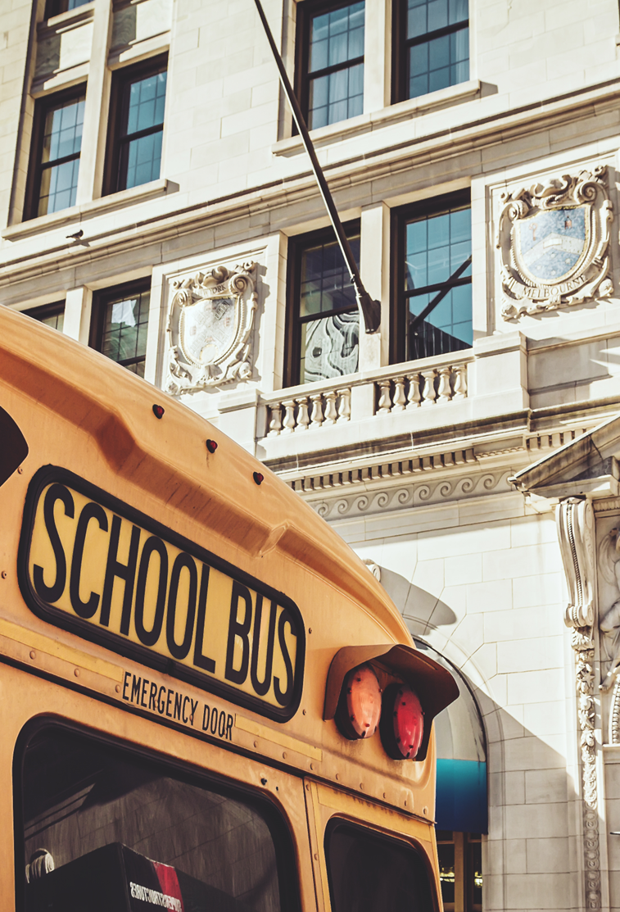
Accelerating Clean Transportation (ACT) School Bus Program
Electrifying School Buses Across Massachusetts
Rachel Ackerman, Senior Program Director
Ruedi Hauser iii, Program Manager
SEPTEMBER 24, 2024

Slide 8
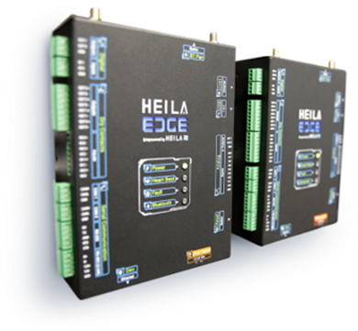
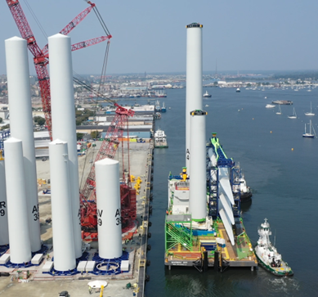
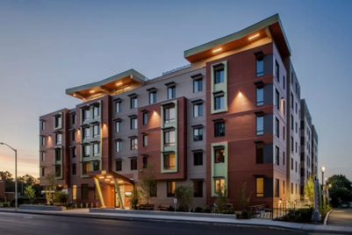
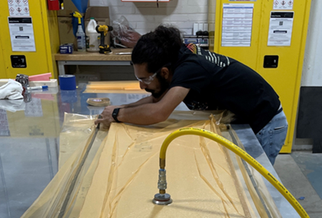
MassCEC Areas of Climate Impact for MA
Climatetech Innovation & Investment | Accelerating Decarbonization | Large Scale Deployment: Offshore Wind | Clean Energy & Climate Workforce Development
We help new climate-focused businesses grow faster by backing a vibrant community of researchers, startups, and established industry players - creating an ecosystem where they connect and thrive. | We contribute to meeting our state's ambitious climate goals by tackling barriers to widespread use of clean energy and climate technology in buildings, transportation, and the grid. | We're building a cutting-edge offshore wind industry, marshaling world-class ports while addressing supply chain and workforce development challenges. | We’re growing a diverse and talented clean energy workforce by supporting a dynamic network of community-based organizations, labor, training providers, schools and employers committed to a sustainable future for all.
Notes:
MassCEC is a quasi-public state agency with the dual mission of reducing GHGs across the state and accelerating MAs clean energy economy. We do this through a few different sectors: our climatetech team works on emerging and early-stage clean energy technology, the offshore wind team deploys offshore wind technology, and our workforce development team supports clean energy job training and placement. This program sits within the accelerating decarbonization sector of MassCEC, which designs and administers grant programs and other funding opportunities to pilot and demonstrate innovative and equitable technologies, business models, partnership structures, etc. so that those learnings can be passed on and scaled across the Commonwealth.

Slide 9
Massachusetts Electric School Bus Landscape
Current School Bus OVERVIEW
Electric School Buses in Massachusetts
Operational Assets
8,000 active school buses
Demographics
300+ school districts
Ownership Model
70% leased, 30% owned and operated
Contracted Operations
Average 3 - 5 year contracts with fleet operators
Operational & Future Assets
250+ electric school buses (ESB)
Demographics Engaging Electrification
15+ school districts have deployed or are in the process of deploying electric school buses (ESB)
Ownership Model
50% leased, 50% owned and operated
Contracted Operations
3 - 5 year contracts with fleet operators
Electrification-as-a-Service contracts of 10+ years
ACT School Bus Program – CESA SLICE 2024

Slide 10
Introduction to the ACT School Bus Program
Program Overview
Program HisTory
Goal
Decarbonize high-polluting school bus sector
Support
Financial and technical aid for school districts and private transportation providers
Focus
Maintaining and expanding momentum for school bus electrification and reducing emissions to support Massachussets Climate Goals
2021 – ACTNow Funding Pilot
Funded (3) School Bus Electrification Pilots
Arlington Public Schools
Beverly Public Schools
Cohasset Public Schools
4 Electric School Buses
Results shaped the current ACT School Bus Program
Demonstrated need for Hands-on Technical Support
2023 – ACT School Bus
Fleet Deployment
Leverage Federal EPA funding with complementary State funding for electric school bus procurement and deployment
Advisory Services
Utilize Technical Consultant to analyze fleet operations and develop Full Fleet Electrification Plans as deployment guide
ACT School Bus Program – CESA SLICE 2024

Slide 11
Advisory Services Program

Slide 12
ACT School Bus Advisory Services
Free Fleet Electrification Planning Program
Support for up to 25 school bus fleets in accessing additional funding opportunities
Creates customized feasibility designs, financial models, and procurement plan
School districts OR 3rd party school bus fleets (in partnership with school districts) may directly apply to receive free electrification advisory services
EPA Priority Districts and their project partners are given preference
Goal of geographic and ownership model diversity
Districts currently enrolled: Boston, Springfield, Mashpee, Worcester, Fitchburg, Everett, Medford, Natick, Truro, and Pittsfield
Eligible applicants are welcome to apply for Deployment and participate in Advisory Services
ACT School Bus Program – CESA SLICE 2024

Slide 13
Fleet Deployment Program

Slide 14
Deployment Program – Round 1
Round 1 of Deployment:
Awarded in December 2022 – read the press release and the award memo
MassCEC provided $9,480,490 in state funding to complement federal EPA Clean School Bus FY22 Rebate Program
6 Massachusetts public school districts supported by 2022 ACTSB Deployment funding:
Fall River
$2M to deploy 10 buses
Lower Pioneer Valley Educational Collaborative:
$2M to deploy 25 buses
Lawrence:
$1.7M to deploy 10 buses
New Bedford:
$2M to deploy 14 buses
Quincy:
$355K to deploy 4 buses
Upper Cape Cod Technical Regional School:
$1.5M to deploy 2 buses
ACT School Bus Program – CESA SLICE 2024

Slide 15
Deployment Program – Round 2
Round 2 of Deployment:
Awarded in April 2024 – read the press release and the award memo
MassCEC is currently providing $4,248,527 in funding, in part to complement federal EPA Clean School Bus FY23 Grant Program
5 Massachusetts public school districts supported by 2023 ACTSB Deployment funding:
Fall River
$150K to deploy 10 buses
Boston
$2.5M to deploy 52 buses
Worcester
$750K to deploy 15 buses
New Bedford:
Assistance to deploy 10 buses
Highland/Holyoke
$850K to deploy 5 buses
ACT School Bus Program – CESA SLICE 2024

Slide 16
Deployment Program – Round 3
Round 3 Overview:
Round 3 will complement the federal EPA Clean School Bus FY23 Rebate Program
Award amounts up to $2M per applicant
Approximately $12M available for awards
RPF Response Period – CLOSED July 2024
MassCEC received 15 applications
Total ask - $18.76M
Total leveraged funding - $47.87M (Including $32.78M in EPA awards)
Anticipated Award Announcement – Fall 2024
Technical Consultant: Frontier Energy
ACT School Bus Program – CESA SLICE 2024

Slide 17
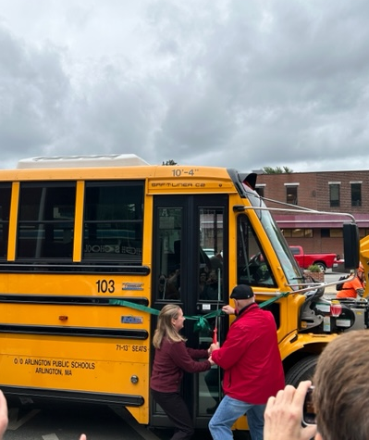
Key Accomplishments of ACT School Bus Fleet Deployment
Program Wins
Massachusetts Priority Districts
65% of districts meeting EPA Priority requirements applied for EPA Clean School Bus (CSB) funding
EPA Awardee Conversion
100% of EPA CSB awardees applied to ACT School Bus
MassCEC Funding Impact
ACT School Bus leveraged more than 5X its awarded funding across three (3) program rounds
External Cost Share
More than $90 million in external cost share deployed by federal, utility, and district sources to support school bus electrification in Massachusetts
ACT School Bus Program – CESA SLICE 2024

Slide 18
Funding & Partnership
Federal & State Funding
Partnership
Federal Funding – Key Applicant Funding
EPA Clean School Bus (CSB) Grant & Rebate Programs
EPA Diesel Emissions Reduction Act (DERA)
State Funding
Utility "MakeReady" Funding
MassDEP DERA
MassCEC ACT School Bus
MOR-EV (State EV Incentive)
Program Impact
Deployment success enhanced through Project Team
Funding Agencies
Technical Consultant
Utility Partnership
Community Engagement
Grantee Partner Support
ACT School Bus Program provides flexible funding for buses, charging infrastructure, and depot upgrades
Complementary Funding by MassCEC
Supports the retention of EPA CSB awards
Diverse Ownership Models
Mitigate high capital cost of equipment and infrastructure construction
Reduce Grantee risk through contracted Technical Consultant
ACT School Bus Program – CESA SLICE 2024

Slide 19
Equity-Focused Approach & Impact of Electrification
Equity & environmental justice
Environment and community Impacts
ACT School Bus Programs Focus
Underserved and overburdened school districts
ACT School Bus Deployment Prioritization
Districts that meet Environmental Justice criteria
ACT School Bus Advisory Services Program
Support for low-income districts to access federal funding opportunities
Enrollment preference is given to districts aligned with EPA Priority requirements
ACT School Bus Program Goals
Commitment to diversity in demographics, geography and ownership-model
Medium and Heavy-Duty Vehicles are among the highest-emitting in transportation
Account for 40% of CO2 emissions in Massachusetts
Health benefits
Reduced diesel emissions
Beneficial for children (LMI/EJ Populations)
Environmental impact
Over 3 million kg of carbon emissions eliminated to date
Establishes path to full-fleet electrification for districts participating in Advisory Services
ACT School Bus Program – CESA SLICE 2024

Slide 20
Collaboration, Replicability, & Lessons Learned
Collaboration & Replicability
Lessons learned
Stakeholder Engagement
Collaboration with state agencies and school networks to inform
Quarterly Cohort Meetings
Addressing Deployment obstacles as they occur
National Outreach
Shared lessons with advocacy groups
NREL, WRI, EPA
Program Design
Communicate best practice to funding and deployment partners looking to replicate program
New Jersey DEP, WRI C.A.F.E. Working Group
Properly Sized EVSE
Which Charger? - Level 2 v. Level 3
Utility Impact
Restrictions on Utility Funding
Single site rule and futureproofing constraints
Site Load Capacity/Depot Location
Demand charges
Third-party Agreements
Overages from electricity cost v diesel on original contract
Pass through funding for districts utilizing a third-party provider
Public Procurement Law v. Electrification-as-a-Service
OEM/Manufacturer Bankruptcy during deployment
Aligning Timelines – contract renewal and ESB deployment
Project champions to ensure deployment execution
ACT School Bus Program – CESA SLICE 2024

Slide 21
Future Goals
Deployment Program
Technical support
State-wide Support
Engage school districts to electrify nearly 8,000 school buses operating across Massachusetts
Focus for Support
Increase equitable access for low-income and disadvantaged communities
Information Resource Coordination
Establishing a centralized, comprehensive source for best-practice documents and deployment guidance
Program Synergy
Expanded support for districts in planning and deployment
Expediting electric school bus deployment while providing insight for full fleet electrification
Case Study: Boston Public Schools
Participant - Advisory Services and Deployment
Advisory Services Program
Recruit additional fleets representing diverse demographics and geography
Support for high-need districts and smaller third-party operators through first-time electrification
Advisory Expansion: Optional Services
Individual support for well-funded districts in need of occasional technical assistance including:
One-on one Coaching Calls
Data Collection Consulting
Focused Technical Assistance for Small/Mid-Size Operators
Cohort Coordination Calls
Q&A Resources
Clean Energy & Battery Storage Assessments
ACT School Bus Program – CESA SLICE 2024

Slide 22
Contact Information
Ruedi Hauser III, Program Manager
CleanTransportation@MassCEC.com
Website
www.masscec.com/program/accelerating-clean-transportation-act-school-bus-overview
Address
Massachusetts Clean Energy Center
294 Washington St, Suite 1150, Boston, MA
ACT School Bus Program – CESA SLICE 2024

Slide 23
Thank you for joining us today!

Slide 24
Thank You
Anna Ziai
Project Director
Clean Energy States Alliance
anna.ziai@cleanegroup.org
www.cesa.org

Slide 25
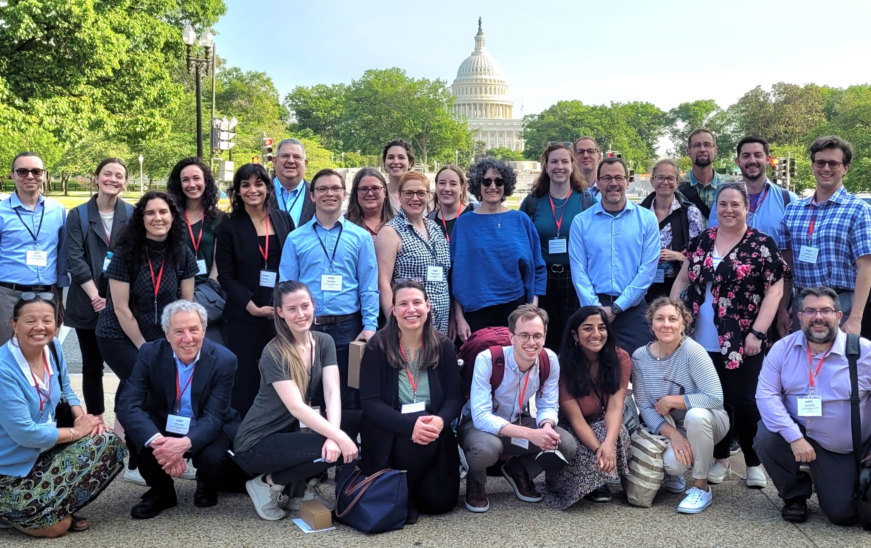
Upcoming
Webinars
info@cleanegroup.org
Collaboration between Community-Based Organizations and State Energy Agencies: Findings and Lessons from the Solar with Justice Project (9/27) Emerging Public Health Needs for Climate Smart Technology in Connecticut Affordable Housing (10/1) An Assessment of Equity in Massachusetts’ Energy Storage Programs (10/8) Sharing Solar Benefits with Multifamily Renters: A Mississippi Case Study (10/30)
Read more and register at
www.cesa.org/webinars
www.cesa.org

